Slide 1


Electric Circuits
Twelfth Edition, Global Edition
Chapter 7 – Part 5
Response of First-Order RL and RC Circuits
© 2024 Pearson Education Ltd. All Rights Reserved.
Notes:
If this PowerPoint presentation contains mathematical equations, you may need to check that your computer has the following installed:
1) Math Type Plugin
2) Math Player (free versions available)
3) NVDA Reader (free versions available)

Slide 2
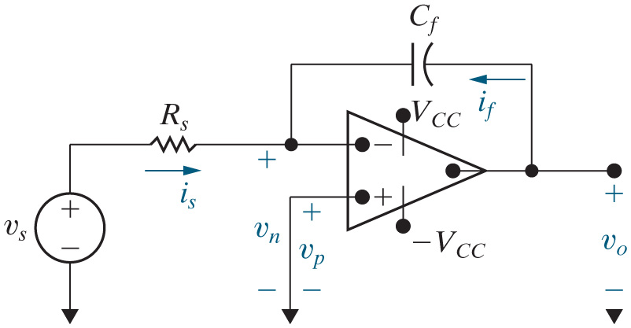
Chapter 7 – Integrating Amplifier (1 of 6)
The integrating amplifier, shown here, is another example of a first-order circuit, because its output voltage is described by a first-order differential equation.

Slide 3


Chapter 7 – Integrating Amplifier (2 of 6)
To analyze this circuit, we write a KCL equation at the op amp’s inverting input node. Assuming the op amp is ideal, the voltage at this node with respect to the reference node is
A.
B.
C. 0

Slide 4


Chapter 7 – Integrating Amplifier (2 of 6)
To analyze this circuit, we write a KCL equation at the op amp’s inverting input node. Assuming the op amp is ideal, the voltage at this node with respect to the reference node is
A.
B.
C. 0

Slide 5


Chapter 7 – Integrating Amplifier (3 of 6)
To analyze this circuit, we write a KCL equation at the op amp’s inverting input node. Assuming the op amp is ideal, the current leaving this node and entering the op amp is
A. 0
B.
C.

Slide 6
Chapter 7 – Integrating Amplifier (3 of 6)
To analyze this circuit, we write a KCL equation at the op amp’s inverting input node. Assuming the op amp is ideal, the current leaving this node and entering the op amp is
A. 0
B.
C.

Slide 7

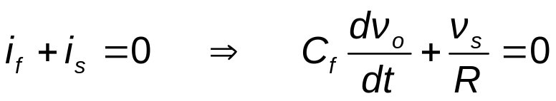
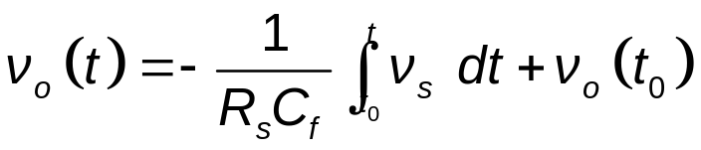

Chapter 7 – Integrating Amplifier (4 of 6)
KCL at
Solving for
So the output of the integrating amplifier is proportional to the integral of the input, limited by the power supply voltages.
Notes:
Long Description:
v subscript o BaseLine Open Parenthesis t Close Parenthesis equals negative Start Fraction 1 over R subscript s BaseLine C subscript f BaseLine EndFraction Integral from t subscript 0 to t of v subscript s BaseLine d t plus v subscript o BaseLine Open Parenthesis t subscript 0 BaseLine Close Parenthesis.

Slide 8
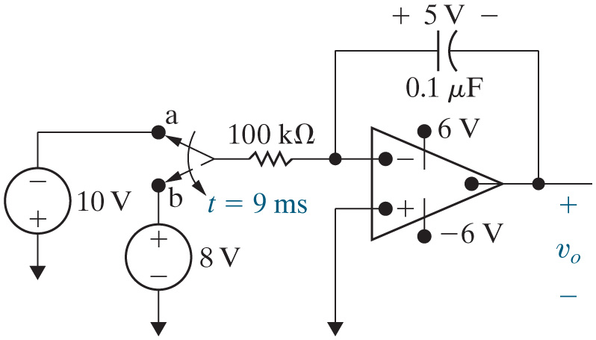
Chapter 7 – Integrating Amplifier (5 of 6)
Example – At the instant the switch makes contact with terminal a in this circuit, the voltage on the capacitor is 5 V. The switch remains at terminal a for 9 ms, then moves instantaneously to terminal b. How many millisecond after making contact with terminal b does the op amp saturate?

Slide 9
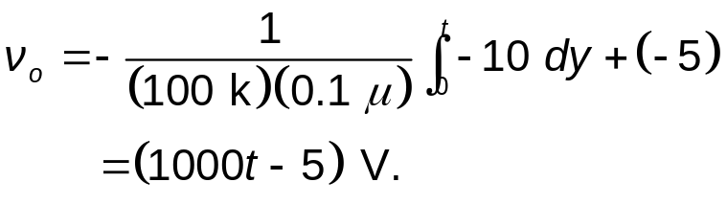
Chapter 7 – Integrating Amplifier (6 of 6)
While the switch is a terminal a, the output voltage is
At 9 ms, the output voltage is
After 9 ms, the output voltage is
After 9 ms, the output voltage is decreasing from 4 V so saturates at −6 V:
Notes:
Long Description:
v subscript o BaseLine equals negative Start Fraction 1 over Open Parenthesis 100 k Close Parenthesis Open Parenthesis 0.1 mu Close Parenthesis EndFraction Integral from 9 m to t of 8 d y plus Open Parenthesis 4 Close Parenthesis equals negative 800 Open Parenthesis t minus 0.009 Close Parenthesis equals Open Parenthesis 11.2 minus 800 t Close Parenthesis Volts.

Slide 10

Copyright
This work is protected by United Kingdom copyright laws and is provided solely for the use of instructors in teaching their courses and assessing student learning. Dissemination or sale of any part of this work (including on the World Wide Web) will destroy the integrity of the work and is not permitted. The work and materials from it should never be made available to students except by instructors using the accompanying text in their classes. All recipients of this work are expected to abide by these restrictions and to honor the intended pedagogical purposes and the needs of other instructors who rely on these materials.

